Slide 1
Predicting Sleep Disorders

Slide 2
Project Overview :
Objective: Develop a machine learning model to predict the presence and type of sleep disorders (None, Insomnia, Sleep Apnea).
Goals:
Improve early intervention strategies.
Optimize patient care.
Enhance overall sleep health.

Slide 3
Project Benefits :
Early Detection: Identify individuals at risk for sleep disorders.
Personalized Care: Tailor treatment plans to individual needs.
Lifestyle Insights: Provide education and prevention strategies.

Slide 4
Key Areas of Focus :
Demographics:
Investigate the impact of gender, age, and occupation on sleep disorders.
Lifestyle Factors:
Analyze correlations between physical activity, stress levels, and sleep disorder prevalence.
Health Indicators:
Study how BMI category and cardiovascular health indicators influence sleep health.
Sleep Quality:
Assess the importance of sleep duration and quality in predicting disorders.

Slide 5
Comparative Analysis of Algorithms :
Algorithms Evaluated:
Decision Tree Classifier
Random Forest Classifier
Criteria:
Model accuracy
Precision and recall for different classes
F1-score to balance precision and recall

Slide 6
Random Forest :
Applied to predict sleep disorders using a comprehensive dataset combining health and lifestyle factors, such as BMI, physical activity levels, stress, and sleep quality.
Utilized to capture complex interactions between variables that single decision trees might overlook, ensuring better predictions for all classes (None, Insomnia, Sleep Apnea).
Accuracy score : 88%

Slide 7
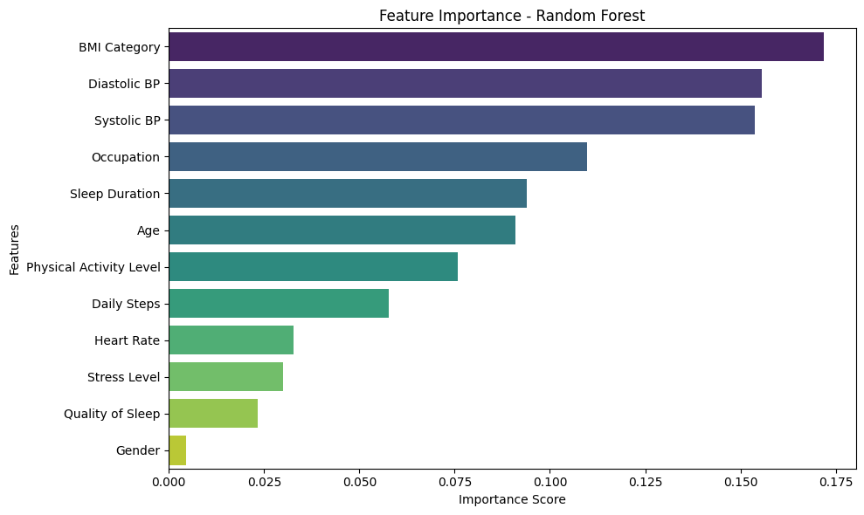
Feature importance :

Slide 8
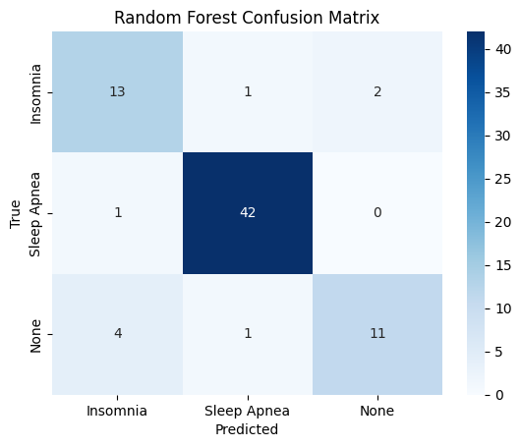
Confusion matrix :
The confusion matrix indicated high recall for predicting "None" but highlighted challenges in distinguishing between "Insomnia" and "Sleep Apnea."
Adjustments such as rebalancing the dataset and fine-tuning hyperparameters were implemented to address these issues.

Slide 9
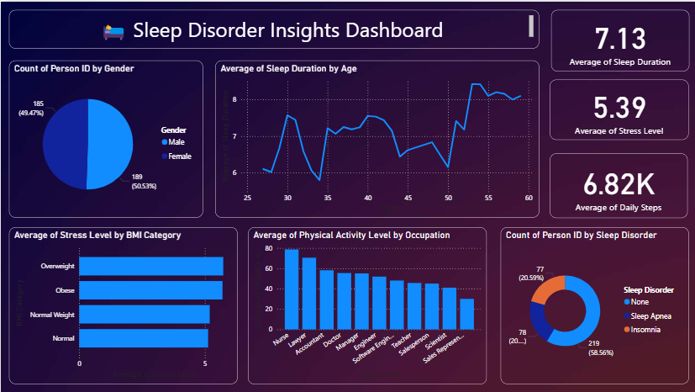
Power bi dashboard :

Slide 10
Conclusion
Summary:
The developed model demonstrates the potential to improve early detection and care for sleep disorders.
Future Work:
Expand feature set by incorporating wearable device data or longitudinal studies.
Deploy the model in a real-world clinical setting for validation.
Call to Action:
Collaborate with healthcare providers to leverage insights for proactive patient management.

Slide 11
Thank you

